Slide 1
WPF Samples
Created | 2020.02.27 | 홍대유
Last Updated

Slide 2
1. Hello WPF 2. XAML 3. Controls 4. Data Binding 5. Routed Event
1. Hello WPF 2. XAML 3. Controls 4. Data Binding 5. Routed Event

Slide 3
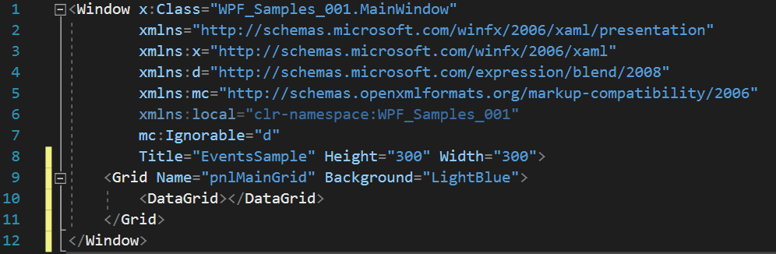
윈도우 내 좌표 구하기 : XAML
WPF_Samples_001

Slide 4
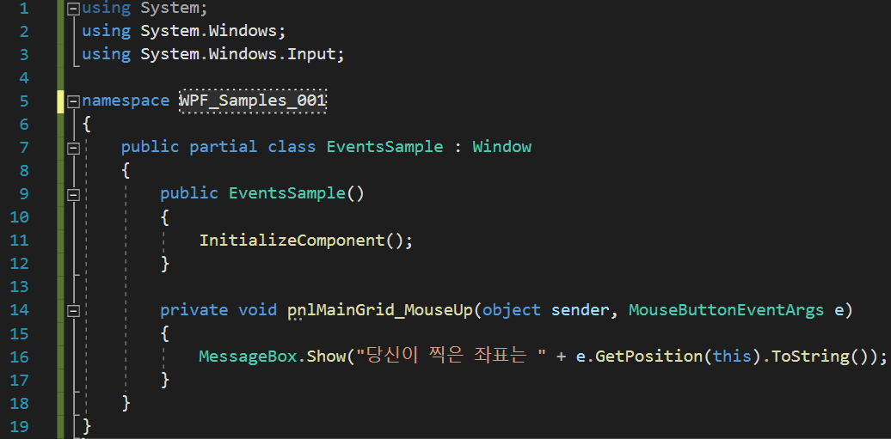
윈도우 내 좌표 구하기 : Code-Behind
WPF_Samples_001

Slide 5
윈도우 내 좌표 구하기 : XAML
WPF_Samples_001

Slide 6
윈도우 내 좌표 구하기 : Code-Behind
WPF_Samples_001

Slide 7
